Slide 1
Dynamic Normalization Network
Achieving global image normalization through local interactions
Diffusion equation models propagation of luminance information over image

Slide 2
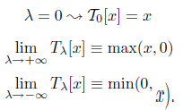
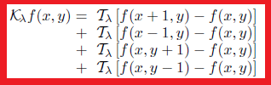
Diffusion equation prerequisites
The diffusion equation is steered by λ parameter, dictating the T operator.
T operator states either no operation, half-wave rectification or inverse half-wave rectification.
K operator applies T operation to the nearest neighborhood of each pixel in the image.

Slide 3
K operator story
Say λ=-inf, then T(λ) operates min(x,0) upon the neighborhood of each pixel.
Take, for example, pixel f(1,1) = min(f(2,1) - f(1,1),0) + min(f(0,1) -f(1,1),0) + min(f(1,2) - f(1,1),0) + min(f(1,0) - f(1,1),0)
For each local pixel, if there exists a decrement in luminance, e.g. f(2,1)-f(1,1) = -1, then the output of min(f(2,1)-f(1,1),0) with be -1.
This writes the value at f(1,1) as the sum of the decrement values in the local surround (into a new array or darkness diffusion layer).
If there is an increment: min(f(2,1)-f(1,1),0) = 0
In this way, the maximum decrement will propagate through the whole diffusion layer, until no other decrements are found.

Slide 4



The diffusion equation
K operator is a component of the diffusion equation
Generic form of diffusion equation
Two diffusion states: “a” applies minimum operator upon local surround, “b” applies maximum operator upon local surround (as described on previous slide).
So at time zero, the solution of the diffusion equation is simply the input stimuli, and as time evolves, the nearest neighborhood interactions develop the two diffusion layers a and b.

Slide 5
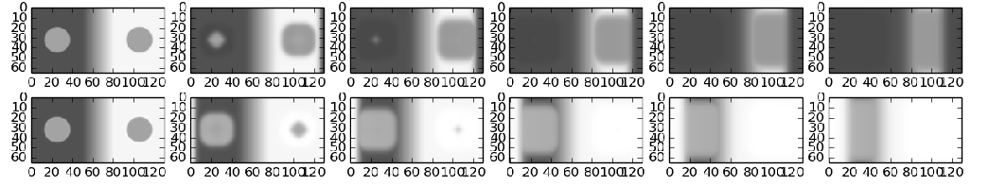
Overview – Bigger EATs Smaller
The diffusion equations, a and b, are solved using the 4th order Runga-Kutta method, which computes unknown future states via iterative computations applied to it's current state. There are simpler ways to computer differential equations, but this is the most robust and accurate.
Luminance diffusion layers (Lightness, b, and Darkness, a,)
a
b
The qualitative effect is that bigger increments (decrements), “eat” smaller increments (decrements) in the lightness (darkness) diffusion layers, until each layer is dominated by the final increment (decrement) value.

Slide 6

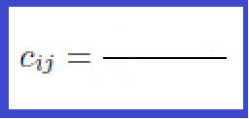

Recombining the two diffusion layers to generate a normalized image
The two diffusion equations (darkness diffusion layer, brightness diffusion layer) are then recombined to generate a normalized image.
Solving these equations we can put them into the linear scaling scheme and dynamic ”ON-type” normalization schemes
stimuli scaled to zero. i.e. subtract the minimum, a
luminance range between darkness and lightness layers (i.e. luminance range)

Slide 7

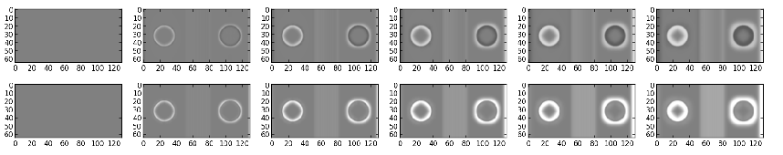
Change in normalized output over time
Top steady-state , Bottom dynamic state

Slide 8
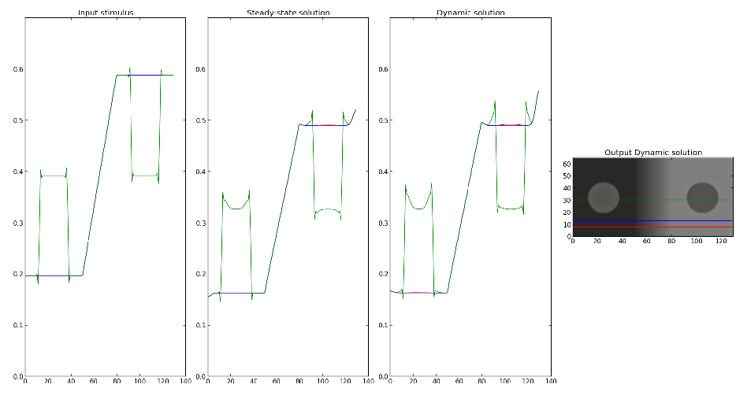
Profile of Outputs

Slide 9

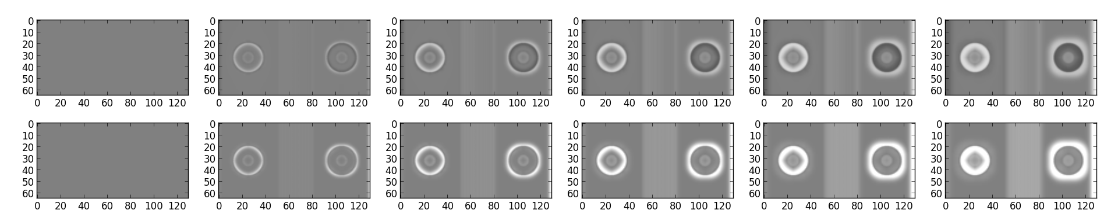
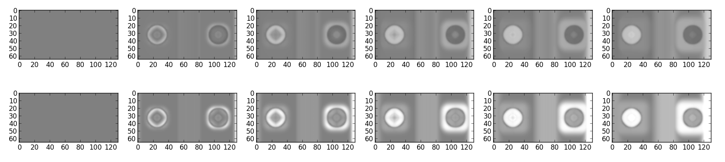
Internal patch
D=0.2
D=0.5

Slide 10
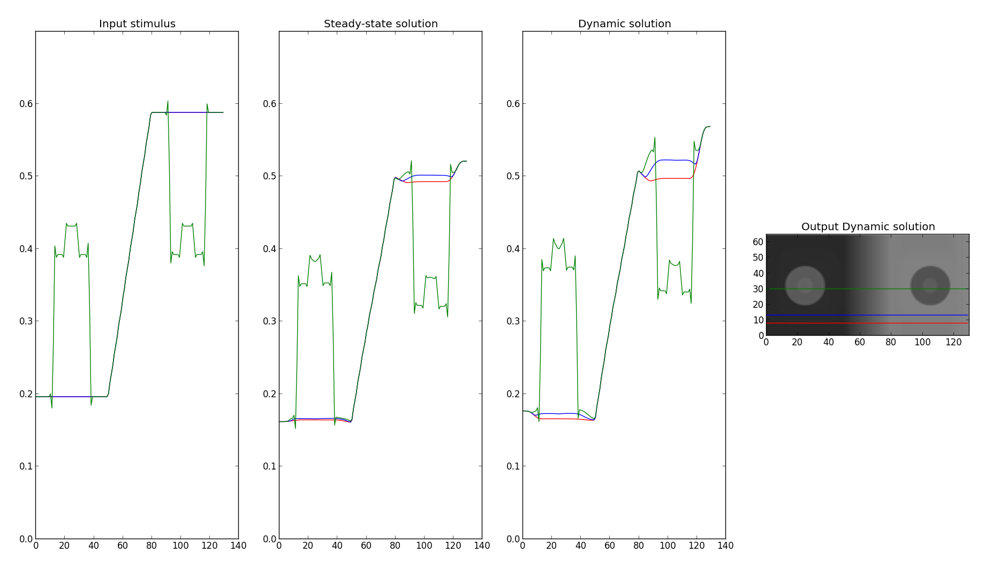
Internal Patch
D=0.5

Slide 11

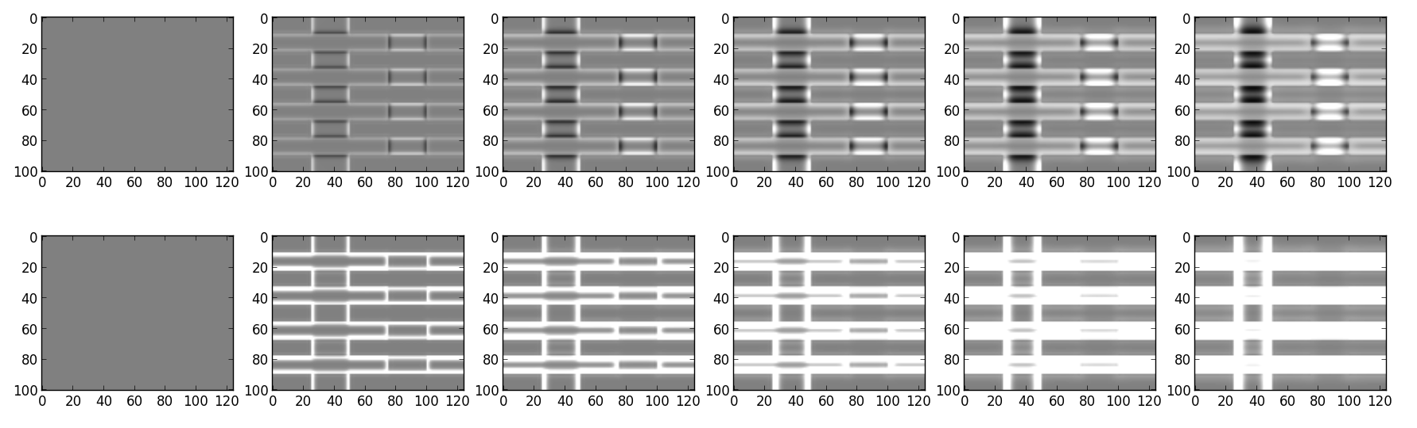
White's

Slide 12
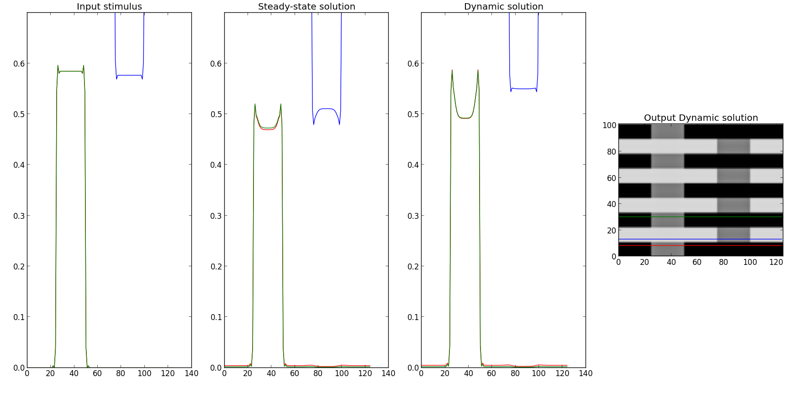
White's

Slide 13
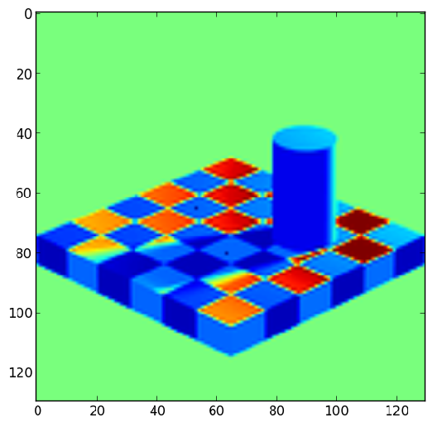
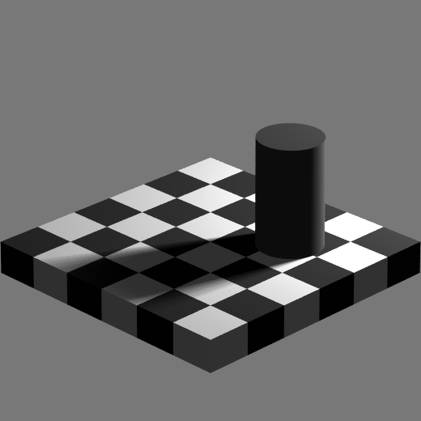
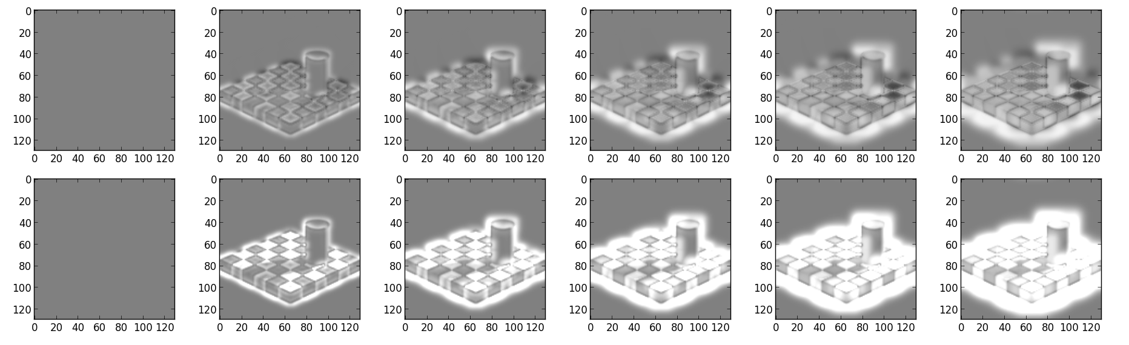
Adelson
No change in difference between test checks

Slide 14
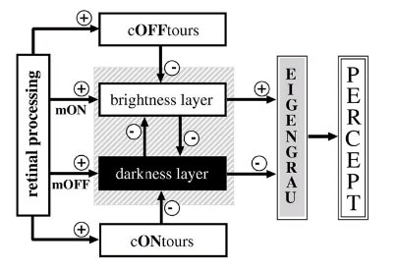
In context of full model
Viewed current output represent end point of normalization process or “brightness layer” diffusion filling-in, also ON-type contrast

Slide 15
Possible future work
Combined with edge detection & FIDO code from Francis model to average normalized change within edge domains
Expand model with cONtours & cOFFtours

Slide 16
Conclusions
Need to confirm stability of output at high diffusion coefficient values
Questionable neurophysiological plausibility
Fails for Adelson's & White's
Luminance information “fills-in” from contrast edges (see real world videos)
Lightness effects observed in SBC with inner patches

